Slide 1

INORGADECK
A card game as valuable education tool
Github link for the code: Click Here
Open the below link to play the game: Click Here Watch the video to see the sample gameplay: Click Here
Presenter:
Rakshit Jangid(22BCE0429)
Tashi Sharma(22BCE0076)
Harshit Agarwal(22BCE3773)

Slide 2
ABOUT US
Welcome to "INORGADECK” a captivating card game designed to make learning inorganic chemistry reactions engaging and fun! Developed by a team of passionate chemists and game designers, our goal is to blend education with entertainment, creating an immersive experience that brings the world of chemical reactions to your fingertips.
Our Mission:
Our mission is to demystify the world of inorganic chemistry, making it accessible and enjoyable for learners of all levels. We believe that hands-on, interactive learning is the key to understanding complex concepts, and what better way to do this than through the excitement of gameplay?
Educational Focus:
At the core of "INORGADECK" is a commitment to education. Each card is meticulously crafted to represent real-world reactants, products, and conditions found in inorganic reactions. As you play, you'll discover the fascinating properties of elements, the magic of ionic bonding, and the power of catalysts.
The Inspiration:
"INORGADECK" was born out of a desire to transform the often intimidating world of chemical reactions into a dynamic, accessible format. Drawing inspiration from classic card games and the fascinating realm of chemistry, we've crafted a game that not only challenges your strategic thinking but also deepens your understanding of inorganic reactions.

Slide 3

Why Play "INORGADECK"?
Learn Through Play: Experience the joy of learning as you play! Every move you make in the game mirrors real chemical reactions, reinforcing key concepts in a memorable way.
Strategic Thinking: Sharpen your strategic thinking as you plan reactions, anticipate opponents' moves, and create chains of reactions for maximum points.
Hands-On Chemistry: No textbooks needed! "INORGADECK" puts the elements in your hands, letting you experiment with reactions and discover the outcomes firsthand.
Join the Chemistry Adventure:
Are you ready to embark on an exciting journey through the world of inorganic reactions? Gather your friends, dive into the world of elements, and let the reactions begin! With "INORGADECK," chemistry is not just a subject—it's an adventure waiting to be explored.
Thank you for choosing "INORGADECK"! Let's React, Learn, and Have Fun!

Slide 4



GAME OBJECTIVES
Learning Goals
The card game aims to reinforce understanding of inorganic reactions, including redox processes, acid-base behavior, and complex formation.
Gameplay
Players engage in activities that simulate inorganic reactions, fostering a hands-on approach to learning key concepts in a dynamic and interactive manner.
Engagement
The game mechanics are designed to encourage active participation, critical thinking, and strategic decision-making related to inorganic chemistry.

Slide 5

Educational Impact and Adaptability
Classroom Integration
The card game serves as a valuable educational tool, complementing traditional teaching methods and promoting active student participation.
Adaptability
The game can be tailored to different educational levels, from high school to higher education, offering a versatile approach to teaching inorganic chemistry.
Assessment and Feedback
Educators can use the game to assess students' understanding of inorganic reactions and provide targeted feedback to support their learning journey.

Slide 6
Card Types and Attributes
REACTANTS CARD
These cards represent the starting materials or substances that participate in a chemical reaction.They serve as an education component,teaching players about real word chemical reactions and principles while they play..
CONDITIONS CARD
These cards represent an alteration in the environment that can significantly impact chemical reactions.They teach players about real world scenarios where temperature adjustments are crucial for controlling reactions.
PRODUCT CARD
These cards represent the end result of a successful chemical reaction.It enhances the educational aspect by teaching about product formation in chemical reactions.It helps players to create valuable compounds for points and gameplay advantages.

Slide 7
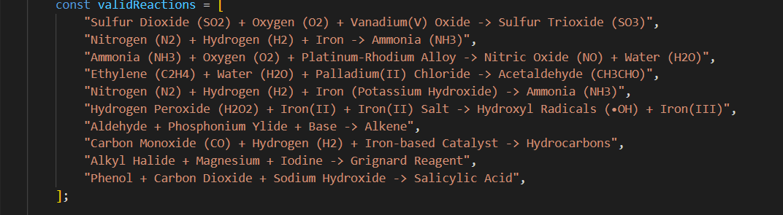
Project Guide
In this project , What we are actually doing is we have a dataset of sample valid reactions in inorganic chemistry and using a gameplay we help the user to learn those reactions by selecting the cards for reactants, reagents and products and If the selected cards after merging matches a valid reaction then the user get one point and the reaction is stored in learned reaction window of the user.
The below is the sample valid reactions dataset :
Source : js/PlayScreen.js

Slide 8
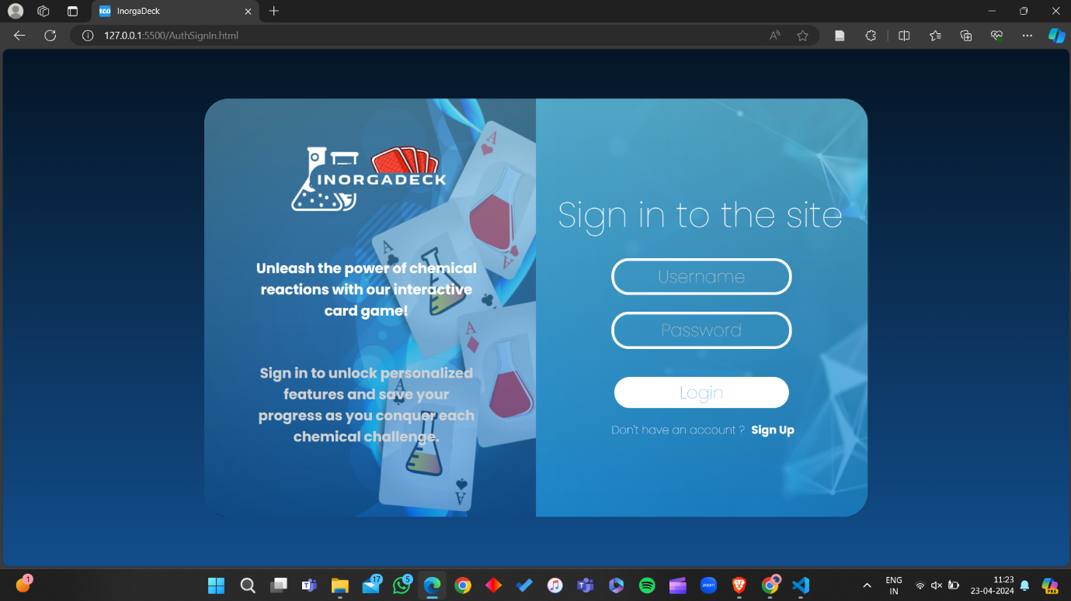
Project Guide
For storing the details of the user and creating a separate storage for the user , we have chosen FIREBASE support for authentication of the user . The below is the authentication screen of the user.
Source : AuthSignIn.html,js/AuthSignIn.js,css/Auth.css

Slide 9
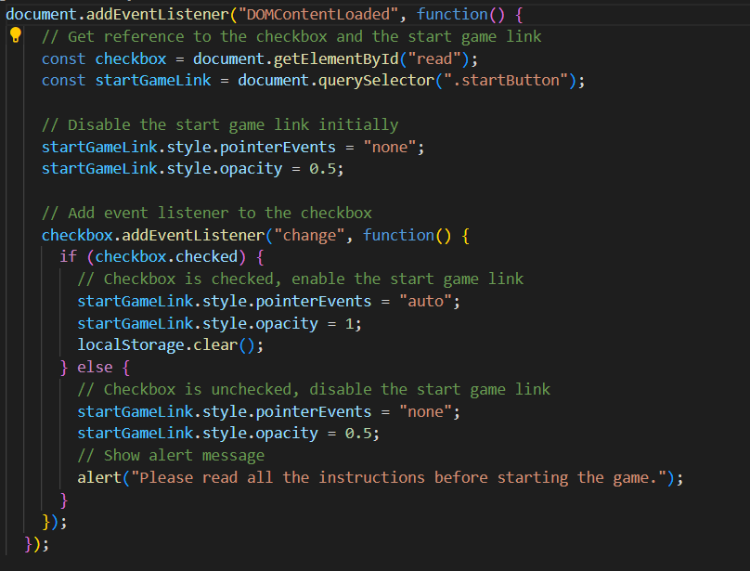
Project Guide
After Authentication the user is navigated towards the general instructions before starting the game , We have implemented a functionality on that page that the user can only start game after he/she has verified that they have read all the instructions .
Basically what we have done is if the checkbox is not checked we have made the pointer property of start game button as none , what that mean is that the user cannot click the button before checking the checkbox. After that the user enters the actual Game Screen and the game starts.
Source: js/GeneralInstructions.js

Slide 10
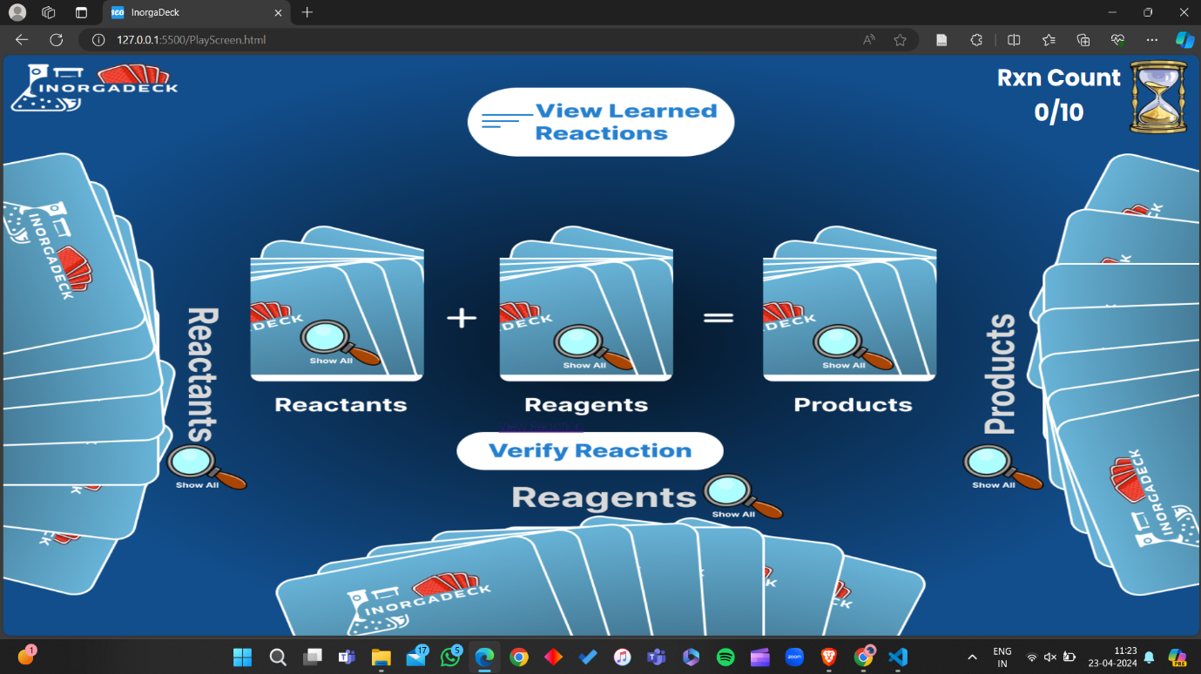
Project Guide
On this screen the user sees 3 sets of card on the three edges of the screen when the user selects any of those he/she is navigated to our card store for that particular set . Assuming the user selects ‘show all’ switch of reactants then he/she will be navigated to the below screen .

Slide 11
Project Guide
On this screen the user sees 3 sets of card on the three edges of the screen when the user selects any of those he/she is navigated to our card store for that particular set . Assuming the user selects ‘show all’ switch of reactants then he/she will be navigated to the All Reactants screen .

Slide 12
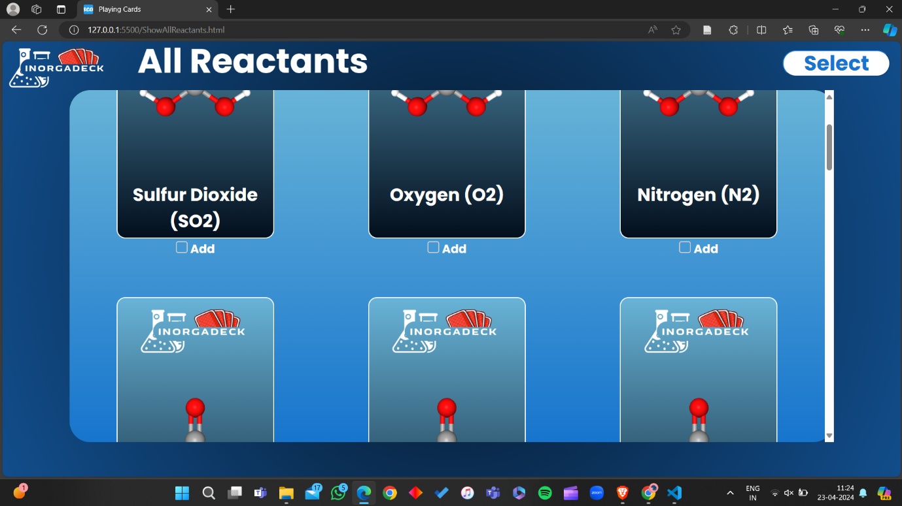
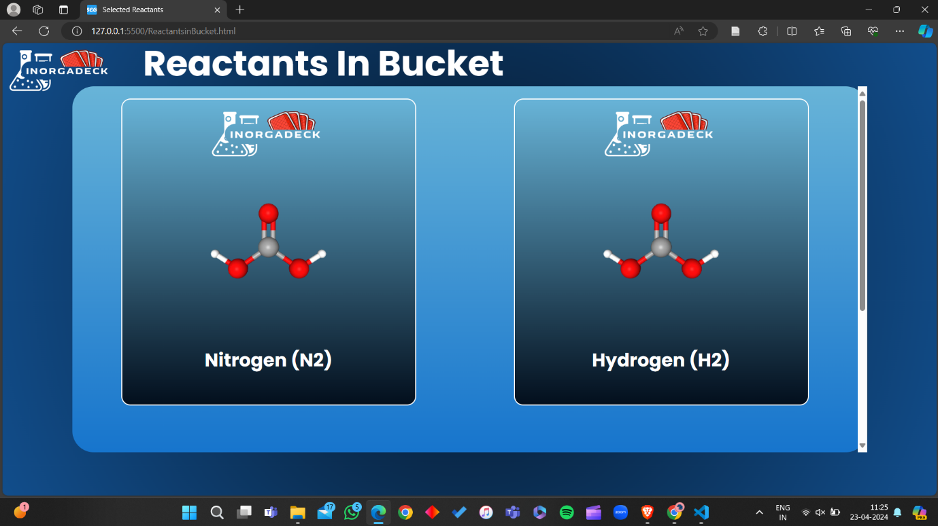
Project Guide
here the user selects those cards which he/she thinks can make a valid rection from reactants point of view , There are checkboxes below every card and the user selects those checkboxes to add those cards to the selected reactants bucket .

Slide 13
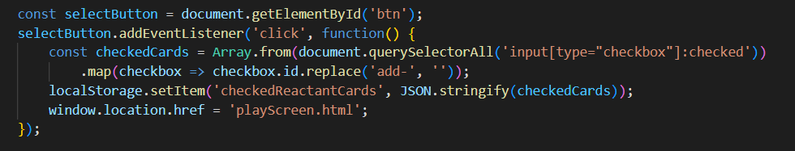
Project Guide
The above code explains how the selected cards index gets stored to the local storage and then are displayed from the local storage to the bucket screen. Similarly the user does this for the reagents and products. Now after selecting all three the reactants , reagents and products for a particular reaction they gets added to the respective buckets .
Source : js/allReactants.js

Slide 14
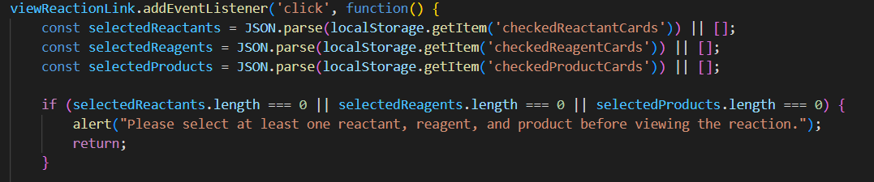
Project Guide
The above code explains how the selected cards index gets stored to the local storage and then are displayed from the local storage to the bucket screen. Similarly the user does this for the reagents and products. Now after selecting all three the reactants , reagents and products for a particular reaction they gets added to the respective buckets .
NOTE: THE USER HAS TO ATLEAST ADD ONE FROM EACH SLOT.
Source : js/allReactants.js

Slide 15
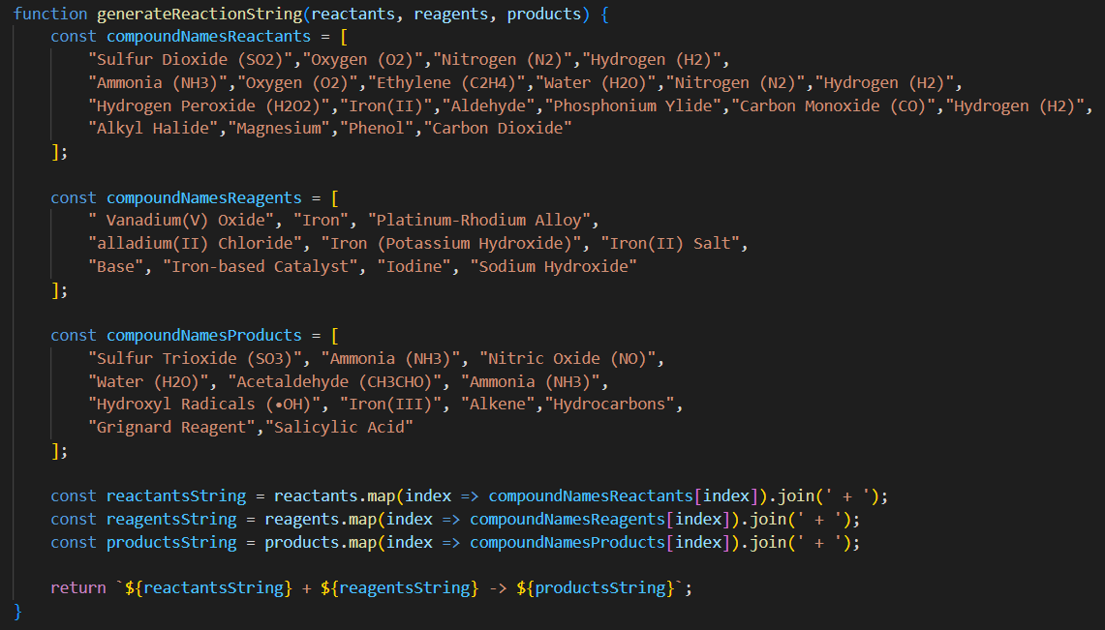
Project Guide
Now we generate the reaction that the user has generated , we have implemented a function for that .
Source : js/PlayScreen.html

Slide 16
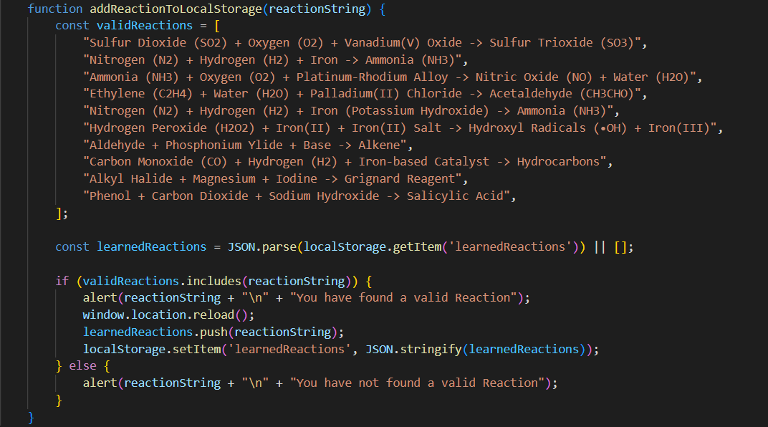
Project Guide
Now the code checks whether the generated reaction is a valid reaction or not using the below function and alerts the user for the same
Source : js/PlayScreen.html

Slide 17
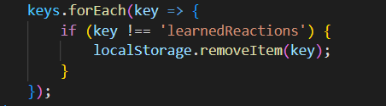
Project Guide
As we see above If the reaction is valid then the reaction is added to the learned reaction local storage .
Source : js/PlayScreen.html
Also after every iteration of the gameplay we clear all the local Storages apart from learned reactions using the above function so that the user has a count and data of learned reactions.

Slide 18
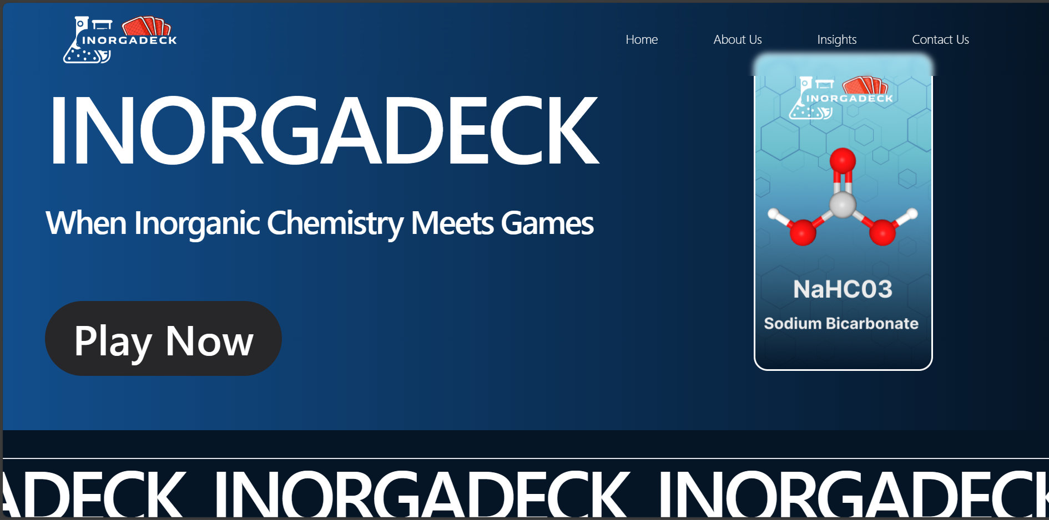
On Boarding Screen
"Welcome to InorgaDeck!
Say goodbye to tedious memorization and hello to interactive learning! InorgaDeck is your ultimate companion in mastering inorganic reactions. Dive into a world where learning feels like playing. Let's embark on this journey together and make mastering inorganic reactions a breeze!"

Slide 19
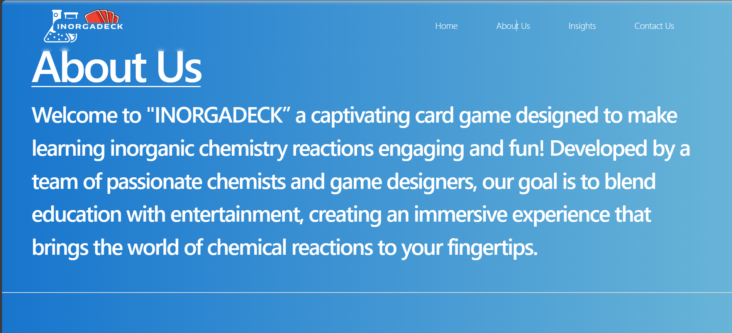
About Us

Slide 20
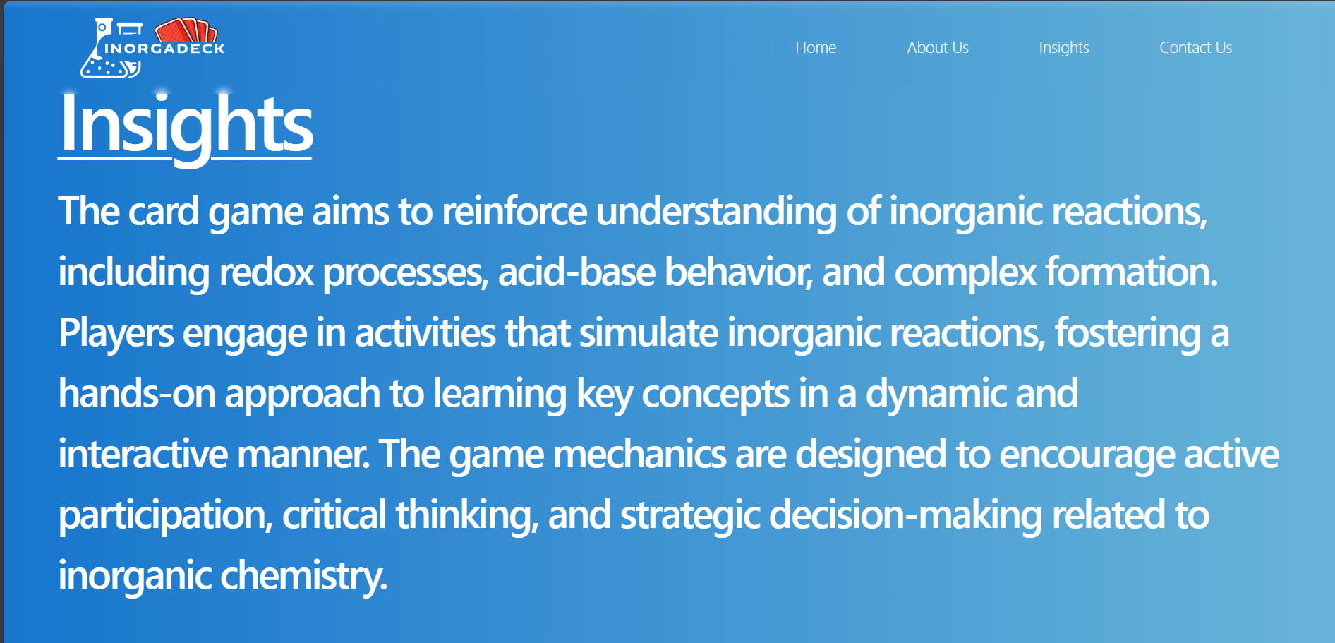
Insights

Slide 21
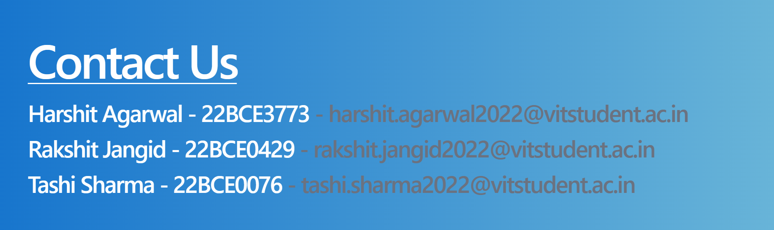
Contact Us

Slide 22
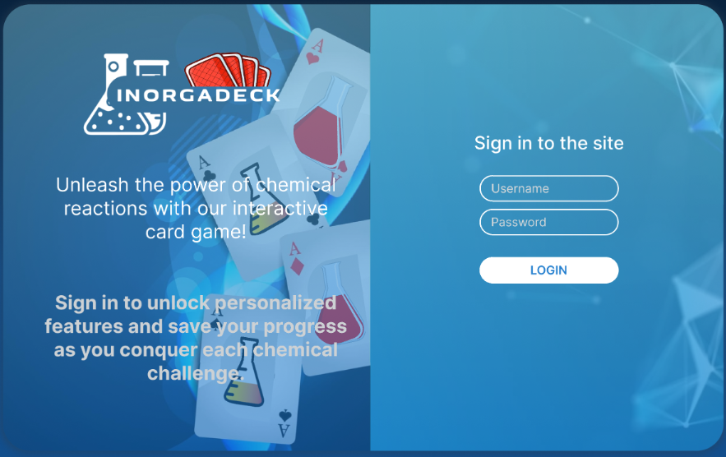
LOGIN SCREEN
Enter your credentials if already registered..Click on signup if a new user.

Slide 23
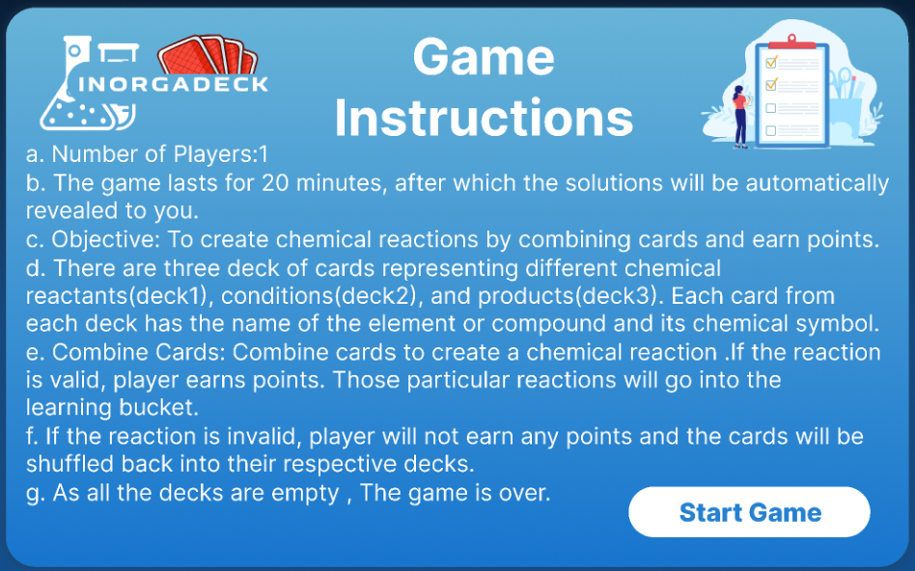
Welcome to "INORGADECK," a strategic card game where you'll dive into the world of chemistry to create, combine, and learn about fascinating inorganic reactions! Before you begin your journey, let's go through the instructions to ensure you're ready to explore the elements and reactions that await
These instructions aim to guide players through the setup, gameplay, and educational aspects of "INORGADECK," setting the stage for an engaging and educational card game experience.

Slide 24
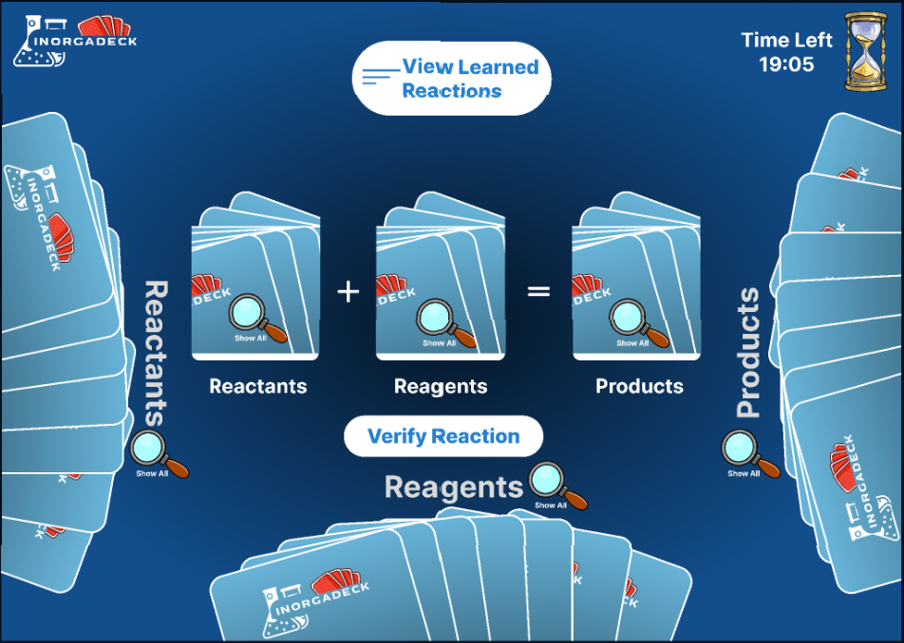
Timer:It’s located on the top right corner of the screen shown.It will show the remaining time on the screen until the game gets over.
Decks:There are 3 decks 1)Reactants
2)Products
3)Conditions
Player can view the respective deck by clicking on the respective magnifying glass.
Feasible reactions made by the player are transferred to the learning bucket.

Slide 25
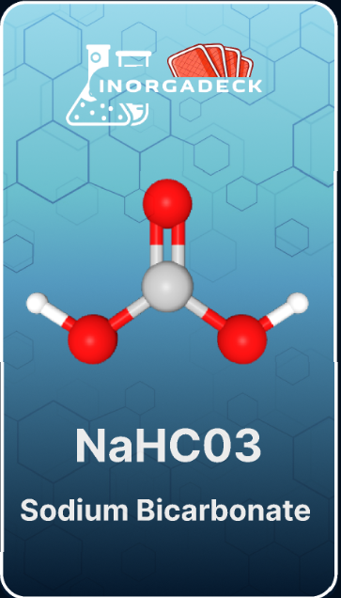
Here a sample playing card is shown.
Real-World Example: Learn about how sodium bicarbonate reacts with common substances like water and oxygen, mirroring real chemical reactions
Concept Reinforcement: Understand the role of sodium bicarbonate as a reactive metal in inorganic chemistry, reinforcing concepts of metal reactivity
This card introduces players to the properties and reactivity of sodium in inorganic reactions, providing a foundation for strategic gameplay and educational insights into real-world chemistry.

Slide 26
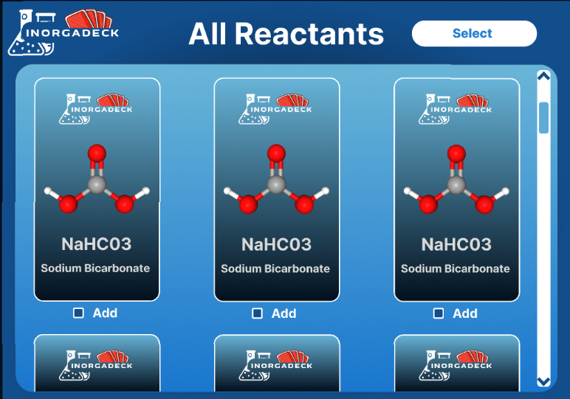
This screen shows all the cards available in the reactants deck.
Each card has an “Add” checkbox at the bottom.
Player can select cards by checking the particular checkboxes.
After selecting the cards click on select option on the top right corner of the window.

Slide 27
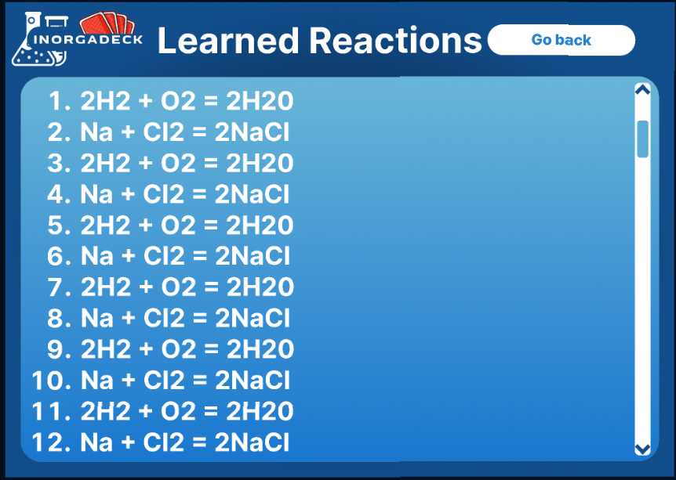
This screen shows all the feasible reactions made by the player.

Slide 28



Benefits of Gamified Learning
Collaborative Learning
The game encourages collaborative problem-solving, communication, and teamwork, fostering a supportive learning environment.
Positive Learning Experience
By integrating play into the learning process, students experience a positive and enjoyable approach to studying inorganic reactions.
Engagement and Motivation
Gamified learning experiences, such as the card game, enhance engagement and motivation, leading to improved knowledge retention.

Slide 29
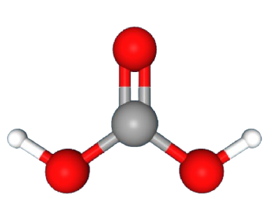
CONCLUSION
Continued Innovation
The integration of gamification in inorganic chemistry education presents opportunities for continued innovation and the development of new educational tools.
Empowering Learners
By embracing gamified learning experiences, educators can empower learners to engage with complex subjects in a dynamic and impactful manner.
Closing Remarks
The presentation concludes with a call to embrace gamified learning as a catalyst for transforming the educational landscape and fostering a deeper appreciation for inorganic chemistry.
Github link for the code: Click Here
Open the below link to play the game: Click Here Watch the video to see the sample gameplay: Click Here

